Slide 1
PHARMA DATA ANALYSIS
SQL
Presentation by
ROOPA T

Slide 2
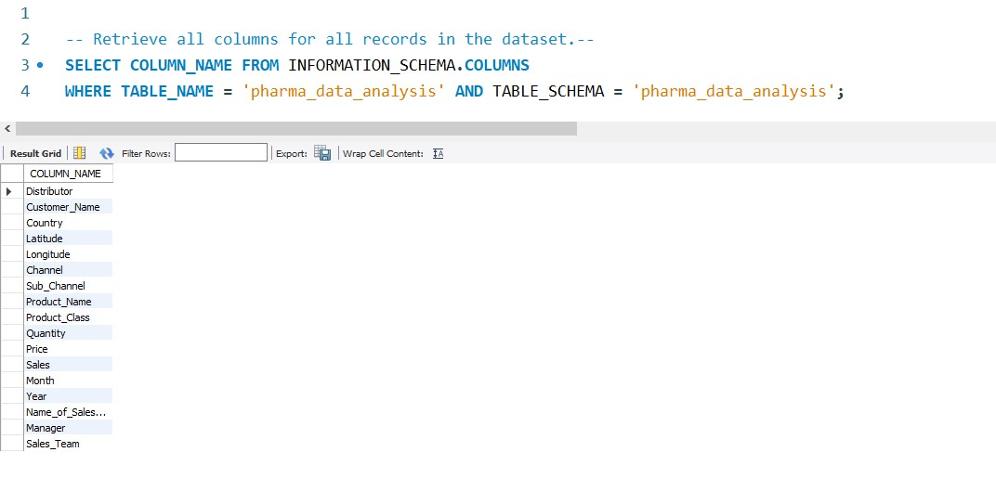
Retrieve all columns for all records in the dataset.
SQL

Slide 3
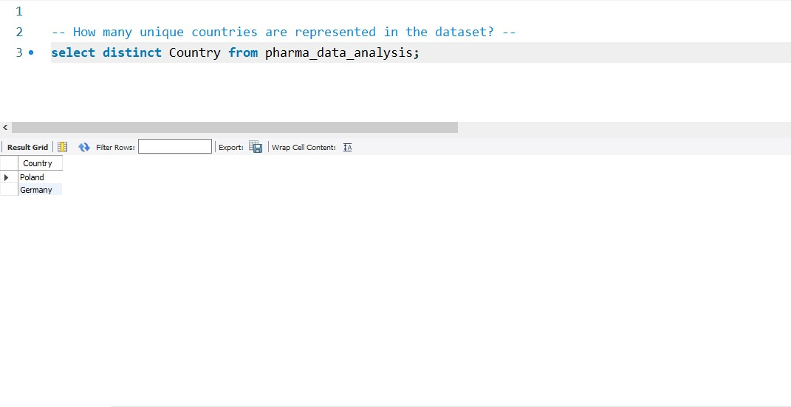
How many unique countries are represented in the dataset?
SQL

Slide 4
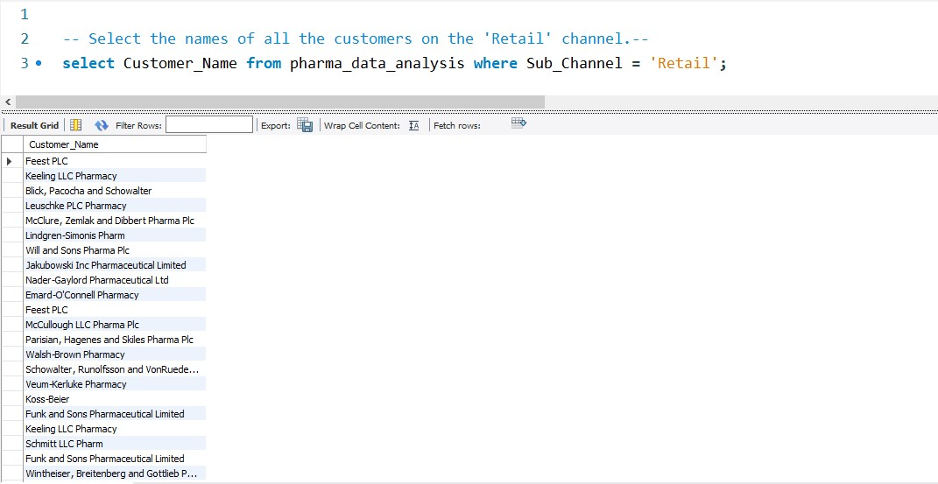
Select the names of all the customers on the 'Retail' channel.
SQL

Slide 5
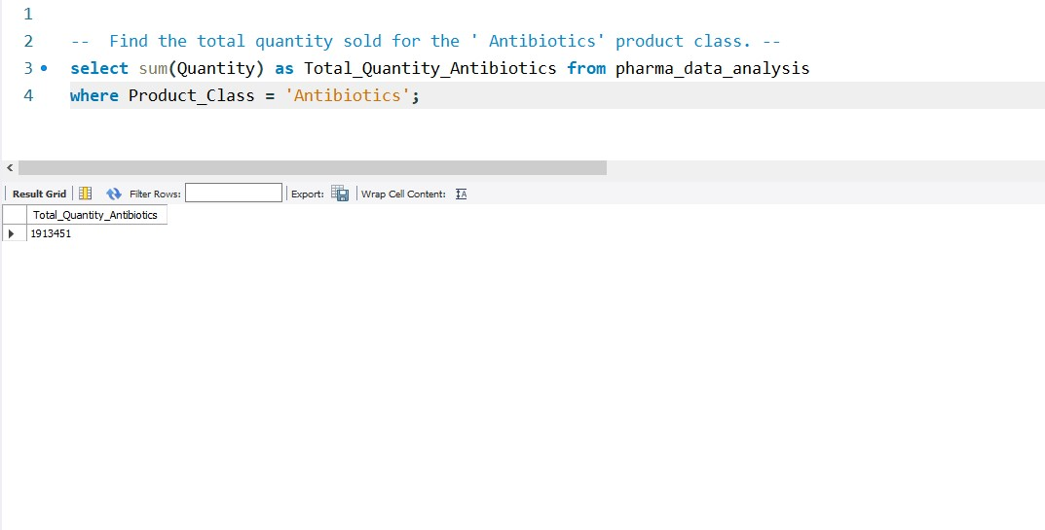
Find the total quantity sold for the ' Antibiotics' product class.
SQL

Slide 6
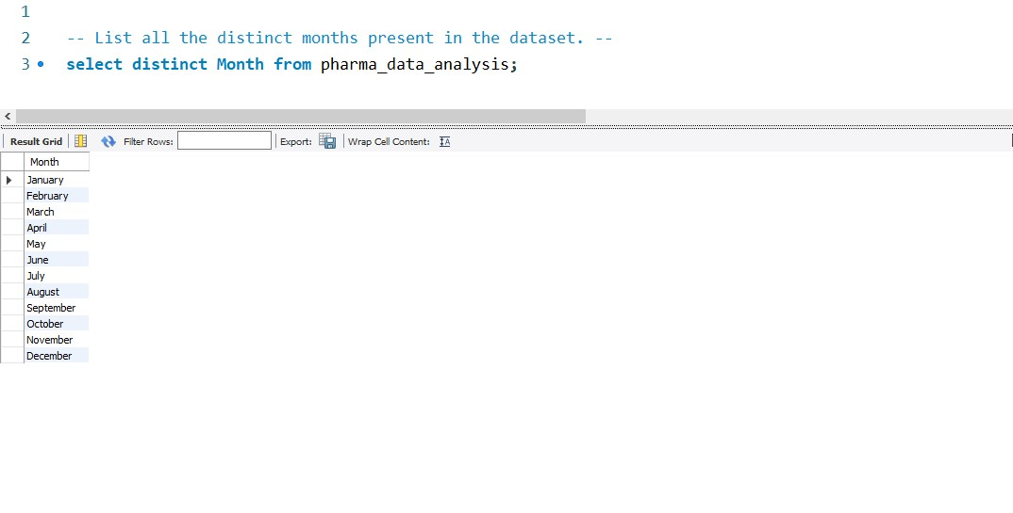
List all the distinct months present in the dataset.
SQL

Slide 7
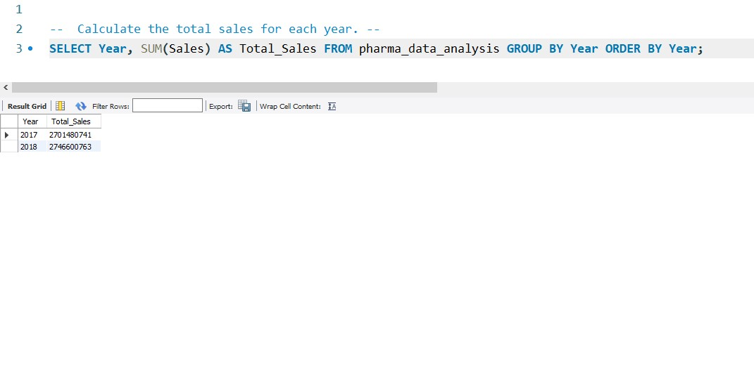
Calculate the total sales for each year.
SQL

Slide 8
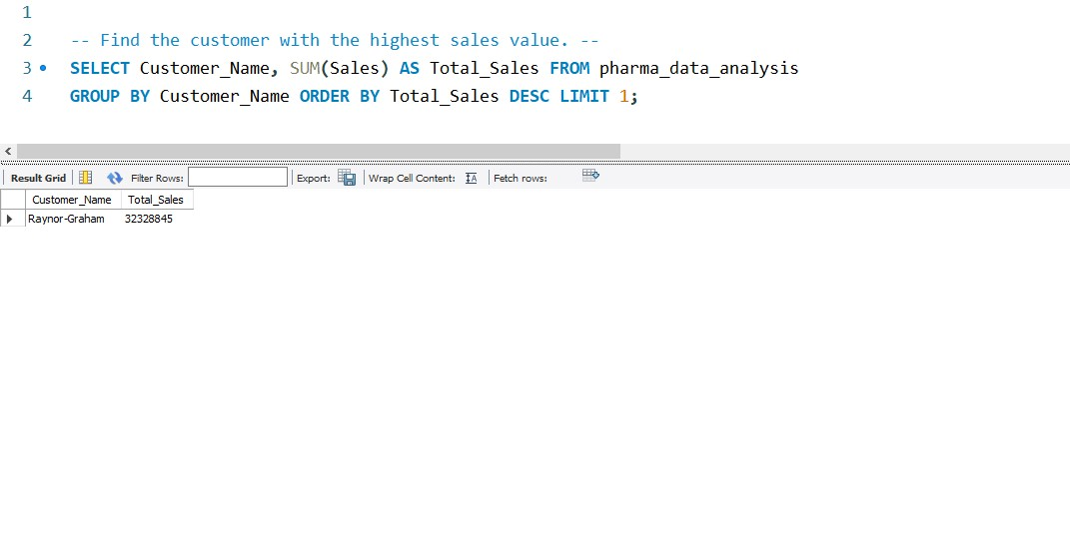
Find the customer with the highest sales value.
SQL

Slide 9
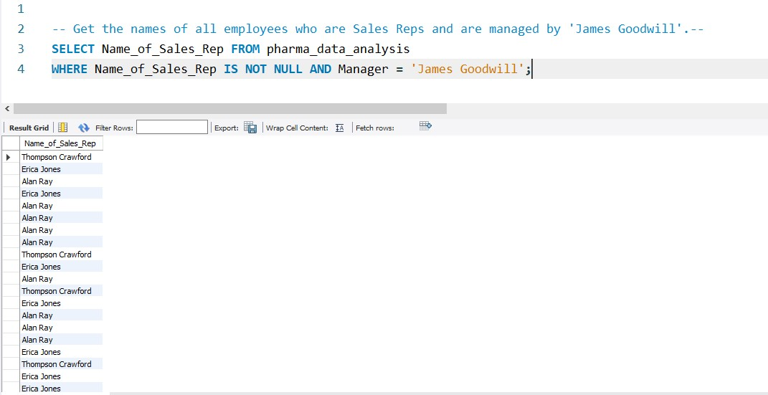
Get the names of all employees who are Sales Reps and are managed by 'James Goodwill'.
SQL

Slide 10
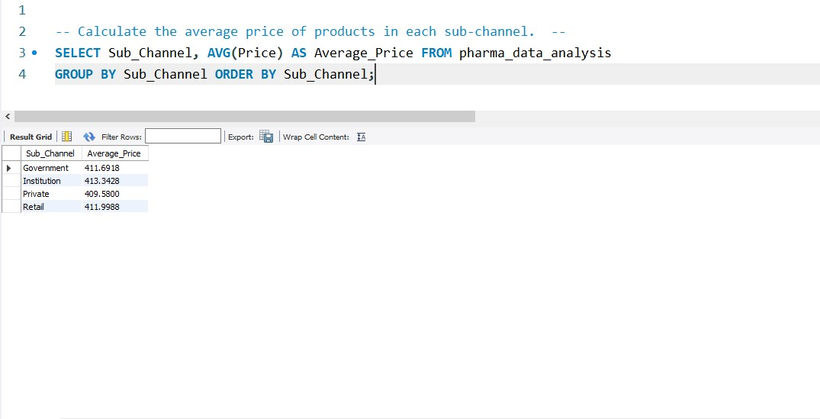
Calculate the average price of products in each sub-channel.
SQL

Slide 11
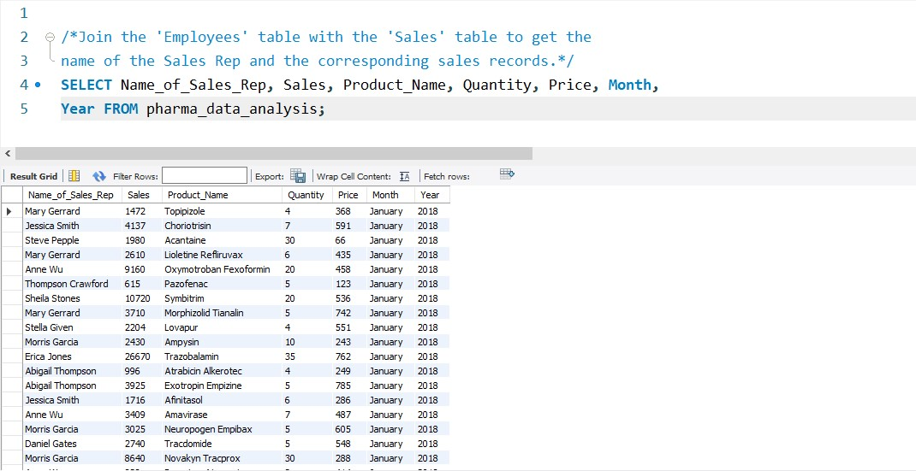
Join the 'Employees' table with the 'Sales' table to get the name of the Sales Rep and the corresponding sales records.
SQL

Slide 12
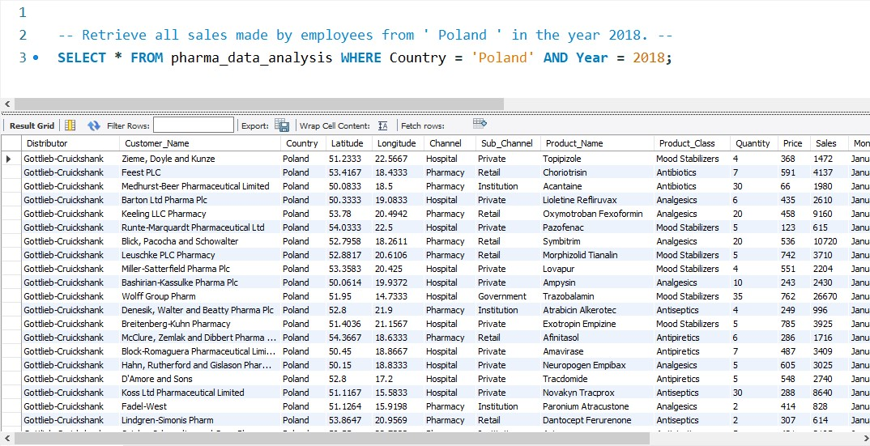
Retrieve all sales made by employees from ‘Poland' in the year 2018.
SQL

Slide 13
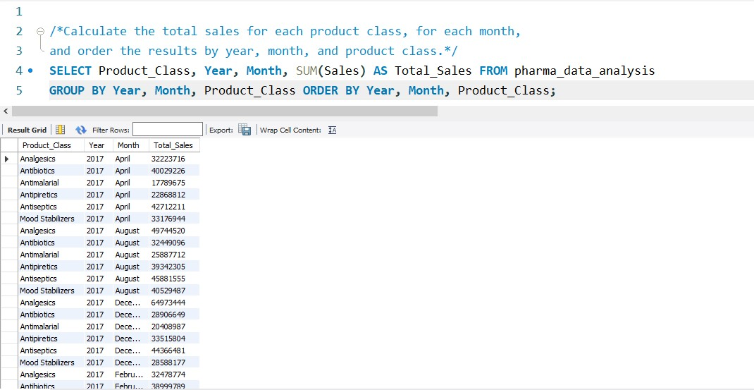
Calculate the total sales for each product class, for each month,and order the results by year,month, and product class.
SQL

Slide 14
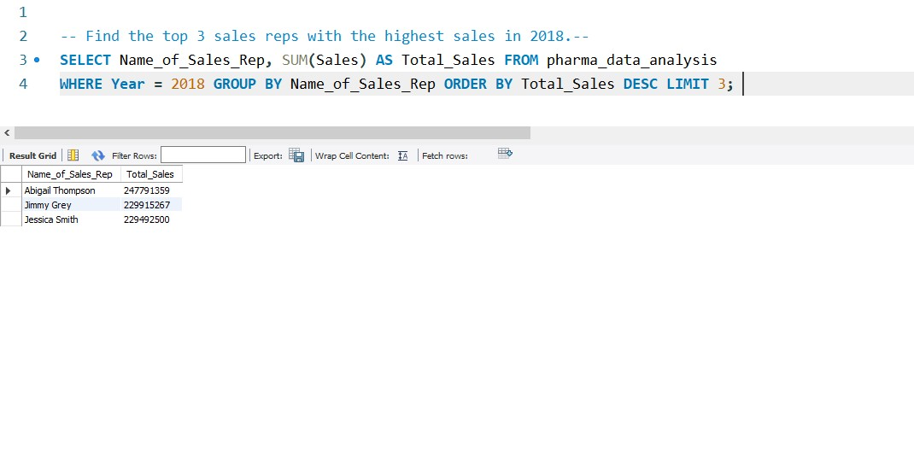
Find the top 3 sales reps with the highest sales in 2018.
SQL

Slide 15
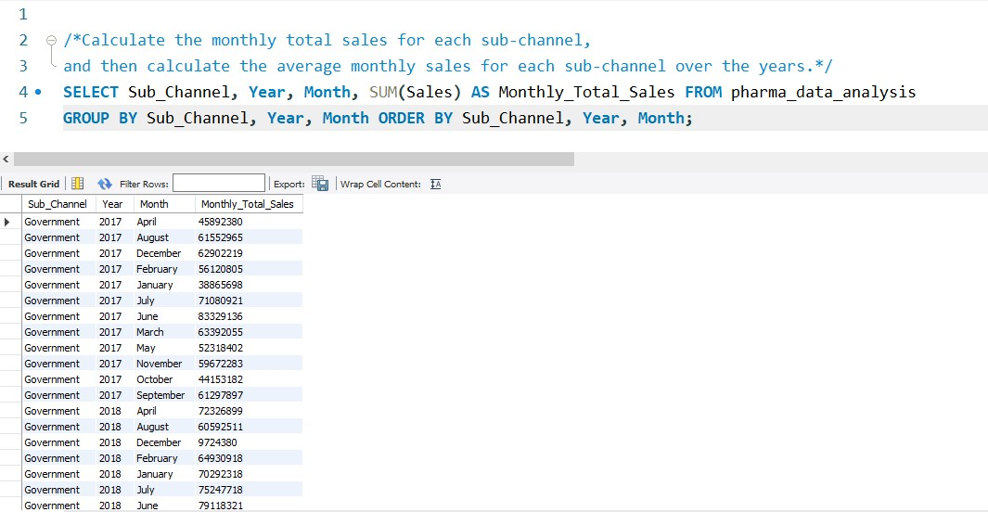
Calculate the monthly total sales for each sub-channel, and then calculate the average monthly sales for each sub-channel over the years.
SQL

Slide 16
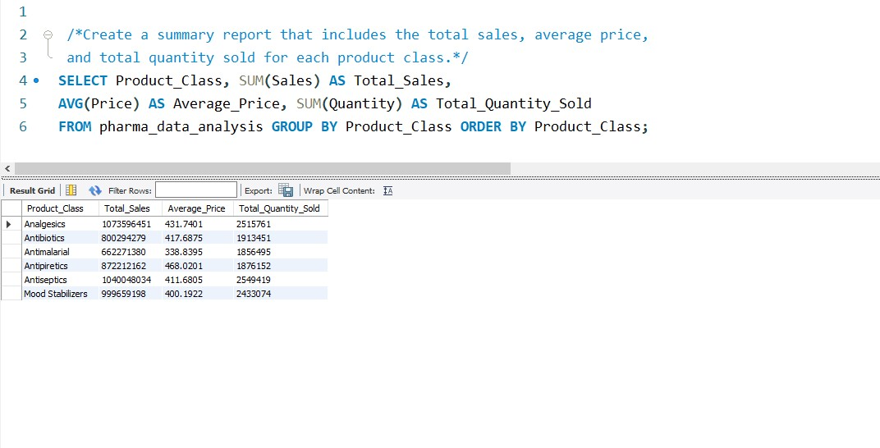
Create a summary report that includes the total sales, average price, and total quantity sold for each product class.
SQL

Slide 17
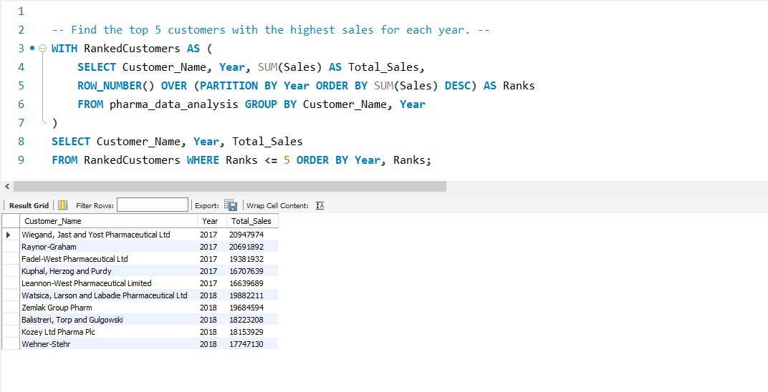
Find the top 5 customers with the highest sales for each year.
SQL

Slide 18
Calculate the year-over-year growth in sales for each country.
SQL

Slide 19
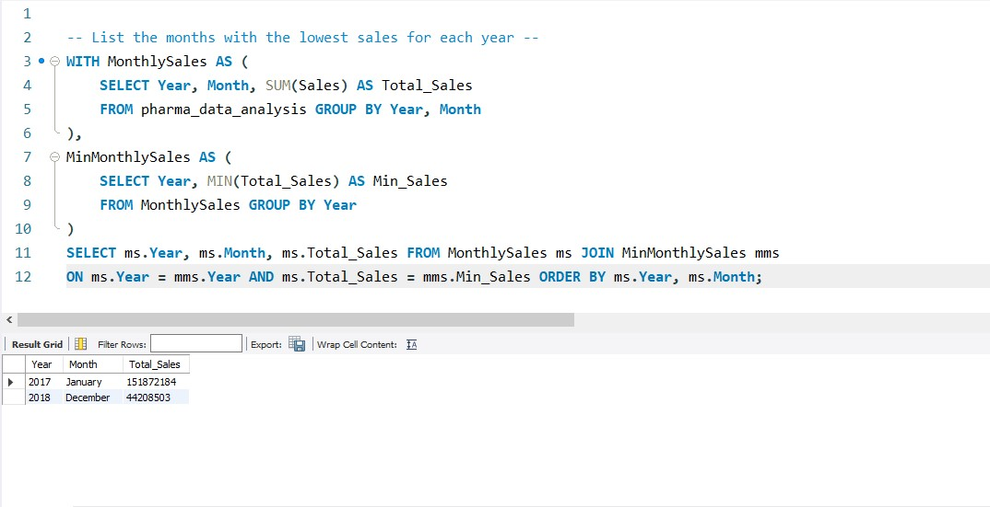
List the months with the lowest sales for each year.
SQL

Slide 20
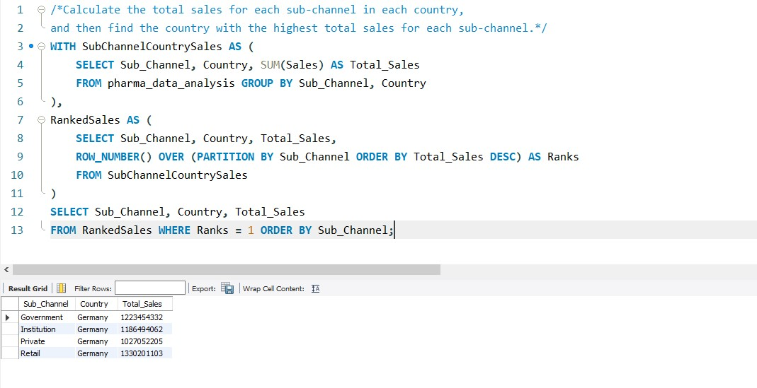
Calculate the total sales for each sub-channel in each country, and then find the country with the highest total sales for each sub-channel.
SQL

